Slide 1
AVR Time Delay and Instruction Pipeline
Delay Calculation of AVR, Pipelining, AVR Multistage execution Pipeline

Slide 2
Delay calculation for the AVR
In creating a time delay using Assembly language instructions, one must be mindful of two factors that can affect the accuracy of the delay:
The crystal frequency
The AVR design

Slide 3
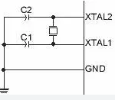
The crystal frequency
The frequency of the crystal oscillator connected to the XTAL 1 and XTAL2 input pins is one factor in the time delay calculation.
The duration of the clock period for the instruction cycle is a function of this crystal frequency.
2. The AVR design:
Advances in both IC technology and CPU design in the 1980s and 1990s have made the single instruction cycle a common feature of many microcontrollers.
One way to increase performance without losing code compatibility with the older generation of a given family is to reduce the number of instruction cycles it takes to execute an instruction.

Slide 4
Timers/Counters

Slide 5
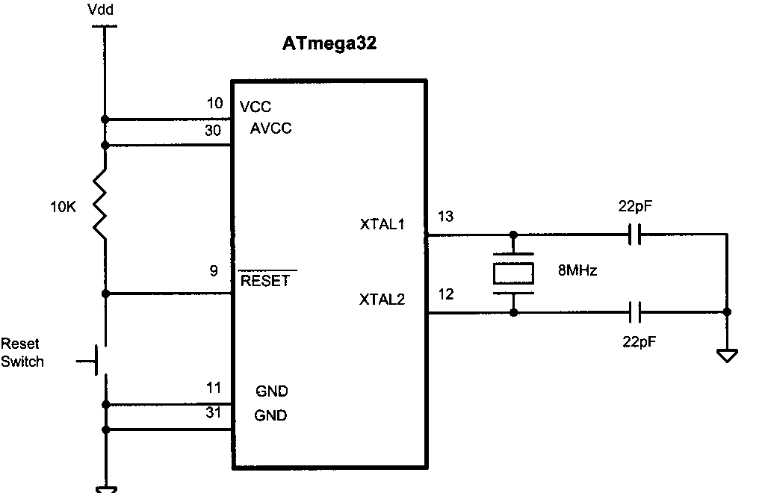

Slide 6
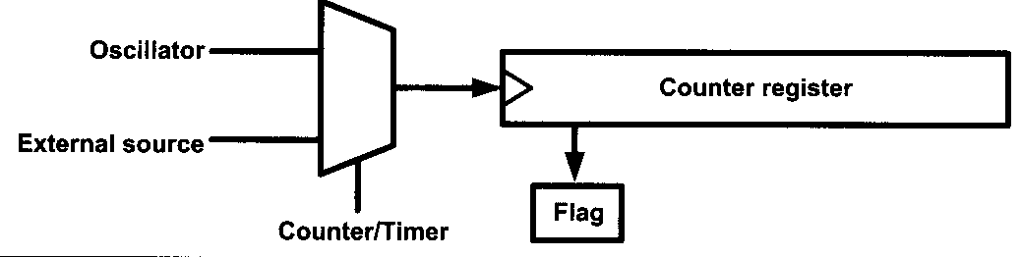
Timer/Counter
Clock input source to counter register
Timer: Internal oscillator
Counter: External source

Slide 7
Timers
The timer is an important application in Embedded systems.
It maintains the timing of an operation in sync with a system clock or an external clock.
The timer has so many applications such as measure time generating delays, generating baud rates to mention just a few.

Slide 8
A normal delay function can be created by a loop iterating for a few 1000 cycles.
But these types of delays need not be accurate and fundamentally it is not a good programming practice.
So, TIMER/COUNTER can be used to generate required delays or to count the time interval between events.
It counts the cycle of the peripheral clock or an externally supplied clock.
The AVR microcontroller ATmega32 has 3 Timers: Timer 0, Timer 1 and Timer 2

Slide 9
Every timer needs a clock pulse to tick.
The clock source can be internal or external.
If we use the internal clock source, then the frequency of the crystal oscillator is fed into the timer.
Therefore, it is used for time delay generation and consequently is called a timer.
By choosing the external clock option, we feed pulses through one of the AVR’s pins.
This is called a counter.

Slide 10
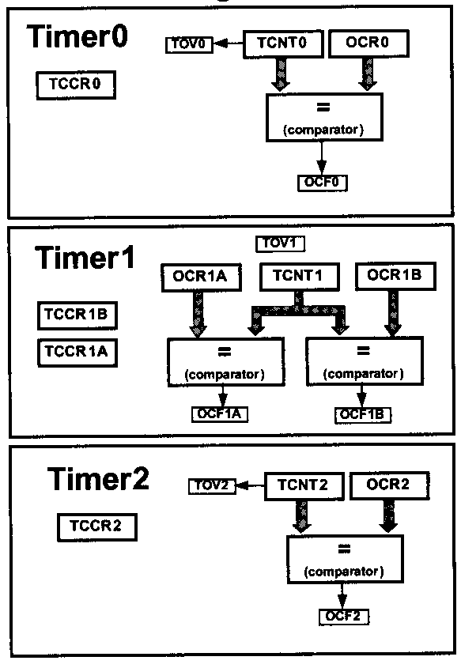
Timers in Atmega32

Slide 11
Timer Registers and Flags
TCNTn (Timer/CouNTer Register)
TOVn (Timer OVerflow Flag)
TCCRn (Timer/Counter Control Register)
OCRn (Output Compare Register)
OCFn (Output Compare Match Flag)
TIFRn (Timer Interrupt Flag Register)
TCCRn
TCNTn
TOVn
=
OCFn
n takes the value 0, 1 or 2.
OCRn

Slide 12
Basic registers of timers
In AVR, for each of the timers, there is a TCNTn (timer/counter) register.
That means in ATmega32 we have TCNT0, TCNT 1, and TCNT2.
The TCNTn register is a counter.
Upon reset, the TCNTn contains zero.
It counts up with each pulse.
The contents of the timers/counters can be accessed using the TCNTn.
You can load a value into the TCNTn register or read its value.

Slide 13
Normal Mode (Timer 0)
TCNT0
FF
FE
0xFF
TOV
TOV
TOV
2
0
time
1
0
TOV0 = 1
0
TOV0:
1

Slide 14
Each timer has a TOVn (Timer Overflow) flag.
When a timer overflows, its TOVn flag will be set.
Each timer also has the TCCRn (timerIçounter control register) register for setting modes of operation.
For example, you can specify Timer0 to work as a timer or a counter by loading proper values into the TCCR0.

Slide 15
Each timer also has an OCRn (Output Compare Register) register.
The content of the OCRn is compared with the content of the TCNTn.
When they are equal the OCFn (Output Compare Flag) flag will be set.

Slide 16
The timer registers are located in the I/O register memory.
Therefore, you can read or write from timer registers using IN and OUT instructions, like the other I/O registers.
LDI R20, 25 ;R20 ← 25
OUT TCNT0, R20 ;TCNT0 ← R20
IN R19, TCNT2 ; R19← TCNT2

Slide 17

Timer0 programming
Timer0 is 8-bit in ATmega32; thus, TCNT0 is 8-bit as shown in Figure

Slide 18
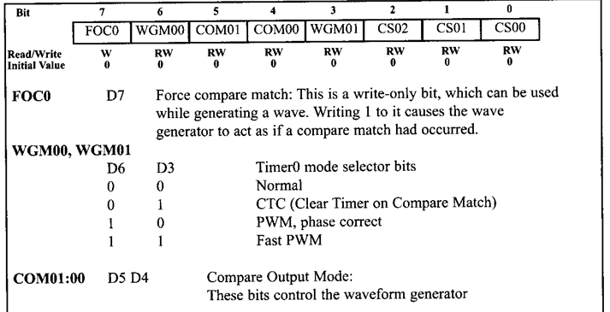
TCCR0 (Timer/control Register)

Slide 19
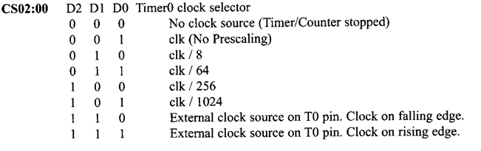
TCCR0 (Timer/control Register)

Slide 20
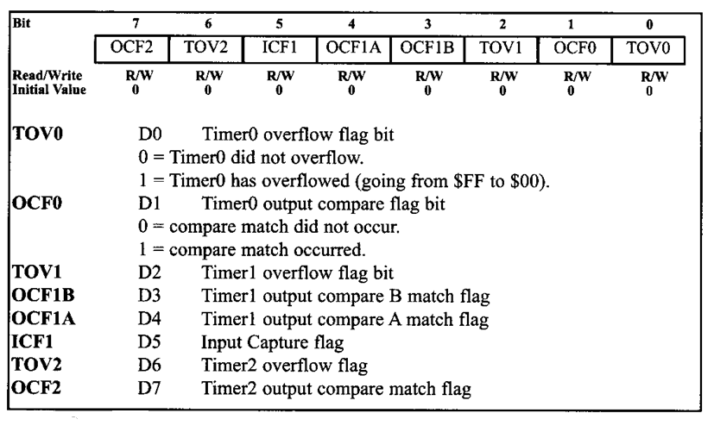
TIFR(Timer/counter Interrupt Flag Register

Slide 21
The timers can be operated in any of 4 modes:
Normal
CTC (Clear Timer on Compare Match),
PWM, phase correct,
Fast PWM.
Now we discuss how to program Timer 0 in normal mode.

Slide 22
Timer 0

Slide 23
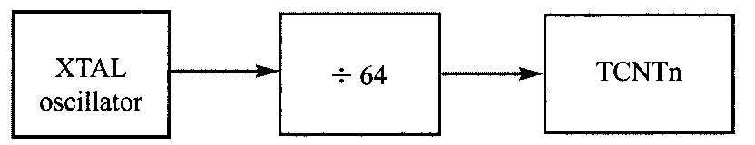
Find the timer’s clock frequency and its period for various AVR-based systems, with the following crystal frequencies. Assume that a prescaler of 1:64 is used. (other values are no prescalar, 8, 256 and 1024)
(a) 8 MHz (b) 16 MHz (c) 10 MHz

Slide 24
a) 8 MHz /64= 125 kHz due to 1:64 prescaler and T = 1/125 kHz = 8 µs
16MHz/64=250kHz due to 1:64 prescaler and T = 1/250 kHz = 4µs
10 MHz /64 = 156.2 kHz due to 1:64 prescaler and T = 1/156.2 kHz = 6.4µs

Slide 25
If the Timer has to create a required delay then the first step is to load a suitable Hex value into the 8bit TCNT0 register.
Assuming that we know the amount of timer delay we need, the question is how to find the values needed for the TCNT0 register.
To calculate the values to be loaded into the TCNT0 registers, we can use the following steps:

Slide 26
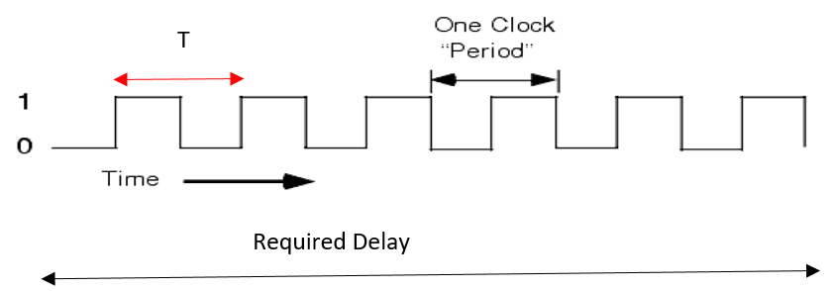
Calculation of XX to be loaded into TCNT0
Required Delay= Count * T ---------------(1)
Count= 256 – XX
Required Delay= (256-XX) * T
XX= 256-Required Delay/T

Slide 27
1. Calculate the period of the timer clock using the following formula:
T_{clock} = 1/F_{Timer}
where F_{Timer} →frequency of the clock used for the timer.
ex: in no prescaler mode, F_{Timer} = F_{oscillator}.
T_{clock} → gives the period at which the timer increments.

Slide 28
2. Divide the desired time delay by T_{clock}. This says how many clocks we need.
3. Perform 256 - n, where n is the decimal value we got in Step 2.
4. Convert the result of Step 3 to hex, where xx is the initial hex value to be loaded into the timer’s register.
5. Set TCNT0 = xx.

Slide 29
Assuming that XTAL = 16KHz, what is the hex value to be loaded into the TCNT0 register to generate a delay of 1ms?
Solution:
T = 1 / F = 1 / 16 kHz = 62.5 µS the period of the square wave.
1ms/ 62.5 µS = 16
256-16 = 240 = F0 H
TCNT0 = 0xF0

Slide 30
Assuming that XTAL = 16KHz, what is the hex value to be loaded into the TCNT0 register create a square wave of frequency 1KHz
Solution:
T = 1 / F = 1 / 16 kHz = 62.5 µS the period of the square wave.
0.5ms/ 62.5 µS = 8
256-8 = 248 = F8 H
TCNTO = 0xF8

Slide 31
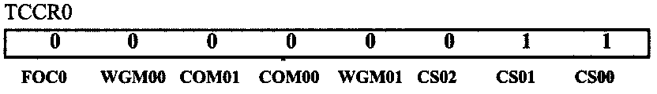
Find the value for TCCRO if we want to program Timer0 in Normal mode with a prescaler of 64 using internal clock for the clock source.

Slide 32
Steps to program Timer0 in Normal mode
To generate a time delay using Timer0 in Normal mode, the following steps are taken:
Load the TCNT0 register with the initial count value.
Load the value into the TCCR0 register, indicating which mode (8-bit or 16-bit) is to be used and the prescaler option. When you select the clock source, the timer starts to count, and each tick causes the content of the timer to increment by 1.

Slide 33
Keep monitoring the timer overflow flag (TOV0) to see if it is raised. Get out of the loop when TOV0 becomes high.
Stop the timer by disconnecting the clock source, using the following instruct ions:
LDI R20, 0x00
OUT TCCRO,R20 ;timer stopped, mode =Normal
Clear the TOVO flag for the next round.
Go back to Step 1 to load TCNT0 again.

Slide 34
ALP Programs

Slide 35
Timer Concept
Count=13 =0x0d
00, 01, 02 ….0A, 0B,……..f2, f3, f4…….. ff
Roll over
Total count=13+1 (Roll over)
If TCNT0=0xf2
Then after every clock tick TCNT0 will increment and finally reach 0xff.
Next clock tick it rolls over to 00

Slide 36
Calculation of XX to be loaded into TCNT0
Required Delay= Count * T ---------------(1)
Count= FF - (XX-1)
=255 - XX +1
=256 - XX
Required Delay= (256-XX) * T
XX= 256-Required Delay/T

Slide 37
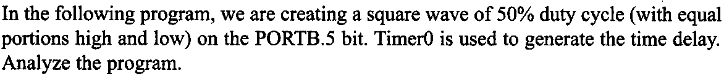
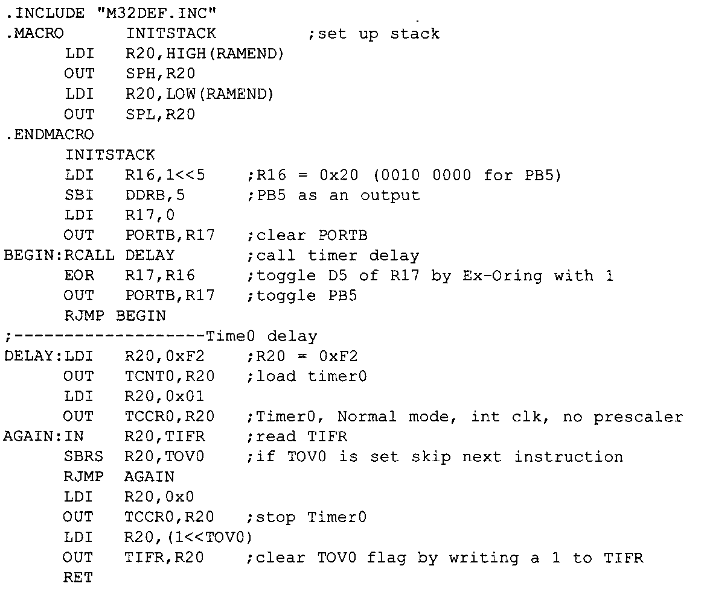

Slide 38
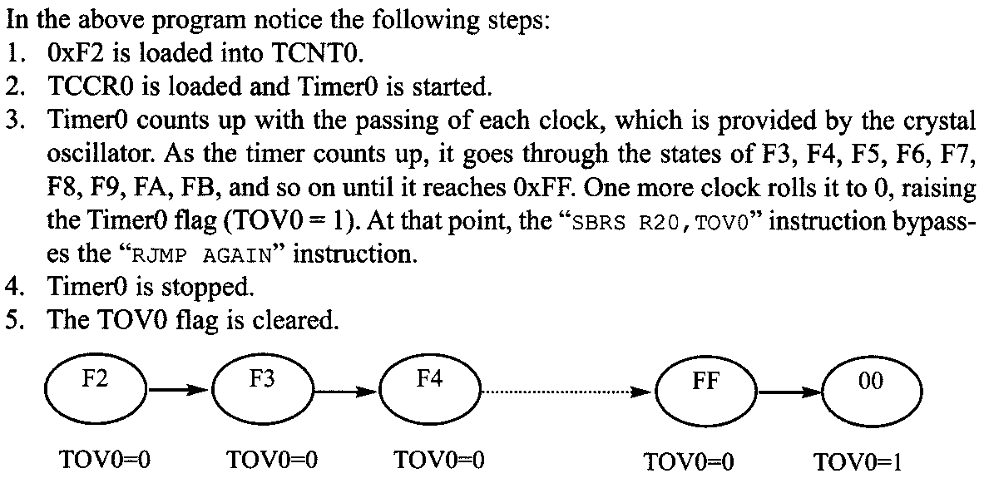

Slide 39
From the above example, calculate the delay generated by the timer. Assume XTAL= 8MHz
We have F=8MHz , T=1/8MHz= 0.125µsec
From the given equation
Required Delay= (256-XX) * T
Given XX=0xf2= 242
Required Delay = (256-242) X 0.125µsec
= 14 x 0.125µsec
= 1.75 µsec

Slide 40
Find the delay generated if TCNT0=0x3e and XTAL =8 MHz
We have F=8MHz , T=1/8MHz= 0.125µsec
From the given equation
Required Delay= (256-XX) * T
Given XX=0x3e= 62
Required Delay = (256-62) X 0.125µsec
= 194 x 0.125µsec
= 24.25 µsec

Slide 41
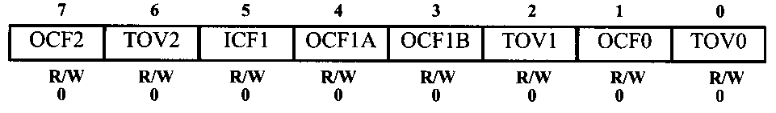

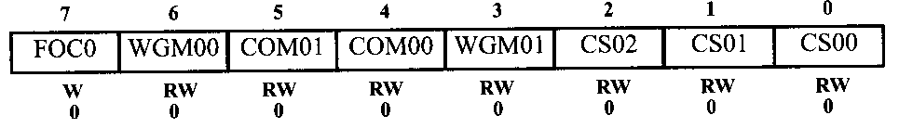

Resetting TOV0 Flag to Zero
Stopping the timer

Slide 42
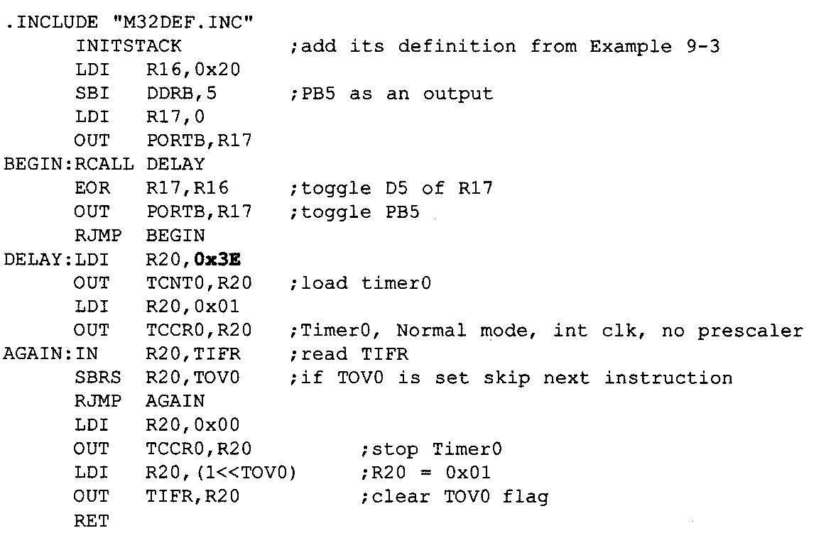
ALP for the above program

Slide 43
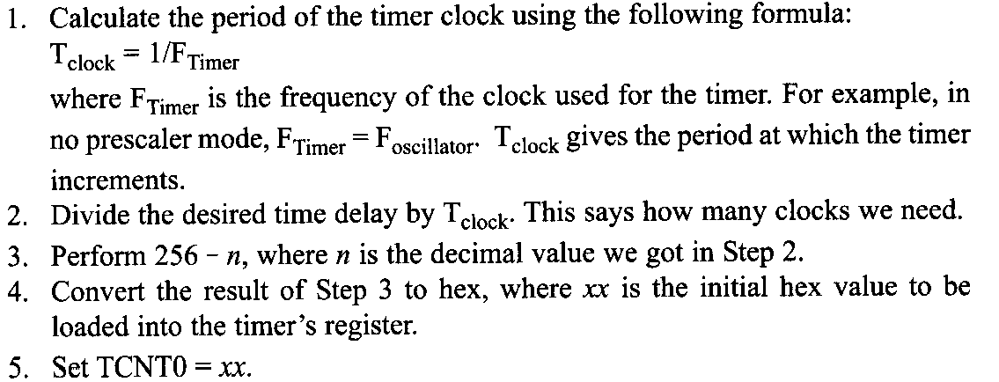
Finding values to be loaded into TCNT0 given delay required

Slide 44
Assuming XTAL= 8MHz, and Time Period=12.5µsec for a square wave, find the value to be loaded into TCNT0.
We have F=8MHz , T=1/8MHz= 0.125µsec
From the given equation
Required Delay= (256-XX) * T
For a square wave with t = 12.5 µsec,
Given, Required Delay= 12.5 µsec /2 = 6.25µsec
XX= 256- Required Delay/T
= 256 – 6.25 µsec/0.125 µsec
= 206
= 0xCE
Therefore TCNT0= 0xCE

Slide 45
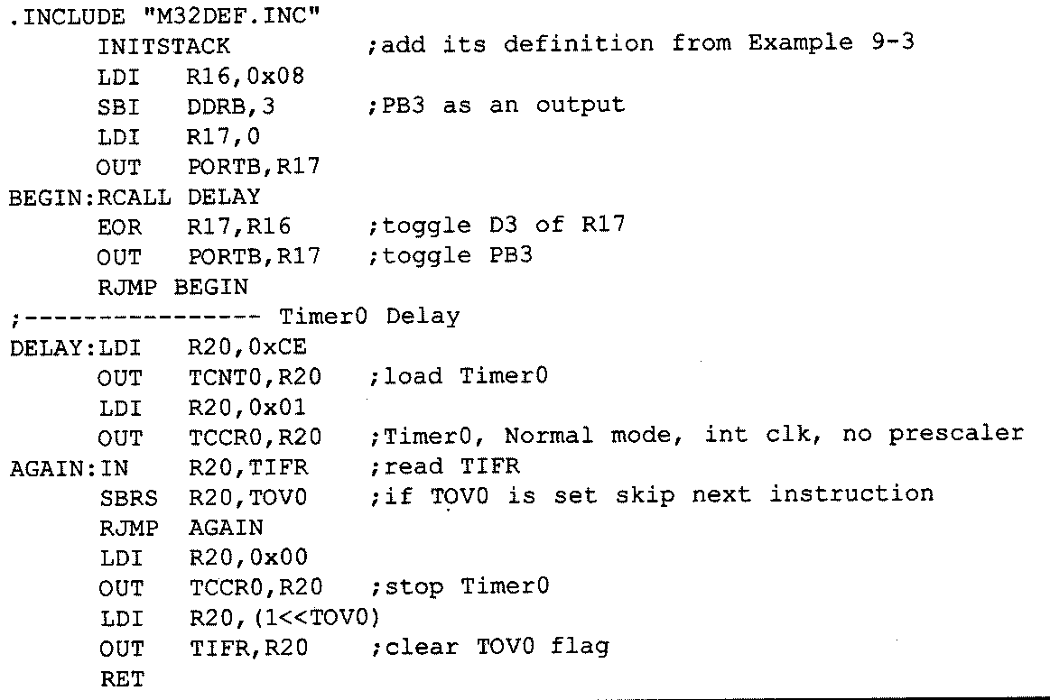
ALP Program for above program

Slide 46
Generate a square wave of 16KHz, Assuming XTAL=8MHz
We have F=8MHz , T=1/8MHz= 0.125µsec
From the given equation
Required Delay= (256-XX) * T
For a square wave with f= 16KHz, t = 1/16KHz= 62.5 µsec,
Given, Required Delay= 62.5 µsec /2 = 31.25µsec
XX= 256- Required Delay/T
= 256 – 31.25 µsec/0.125 µsec
= 256-250
= 6
=0x06
Therefore TCNT0= 0x06

Slide 47
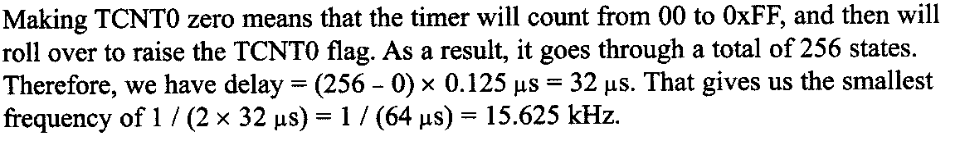
Prescalar and generating longer delays
The size of the time delay depends on 2 factors
The XTAL frequency
The Timer’s 8-bit register
Longest delay is obtained by having TCNT0=0x00
But this may not be enough

Slide 48
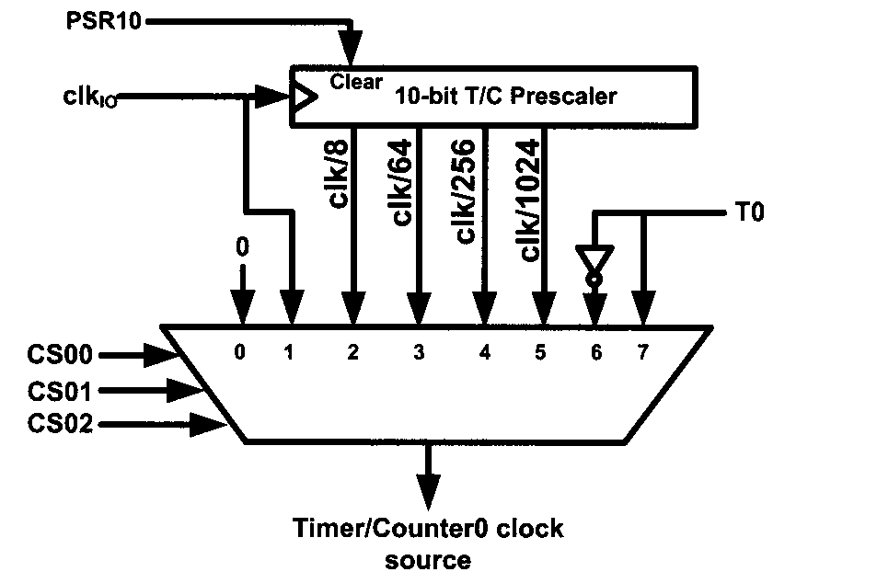

Slide 49
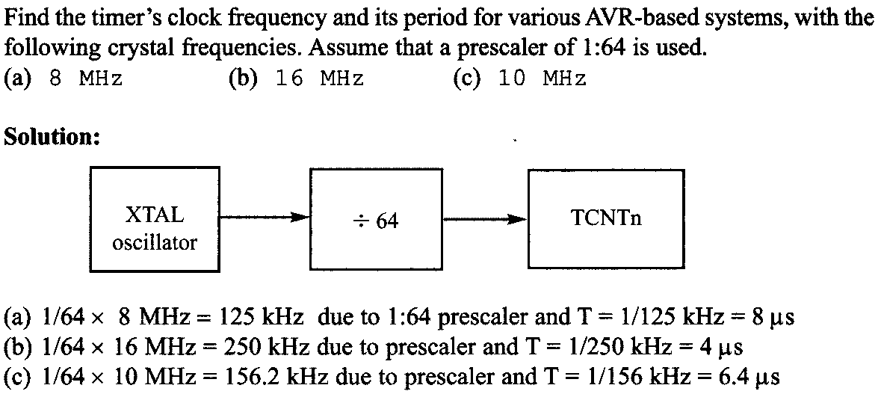

Slide 50
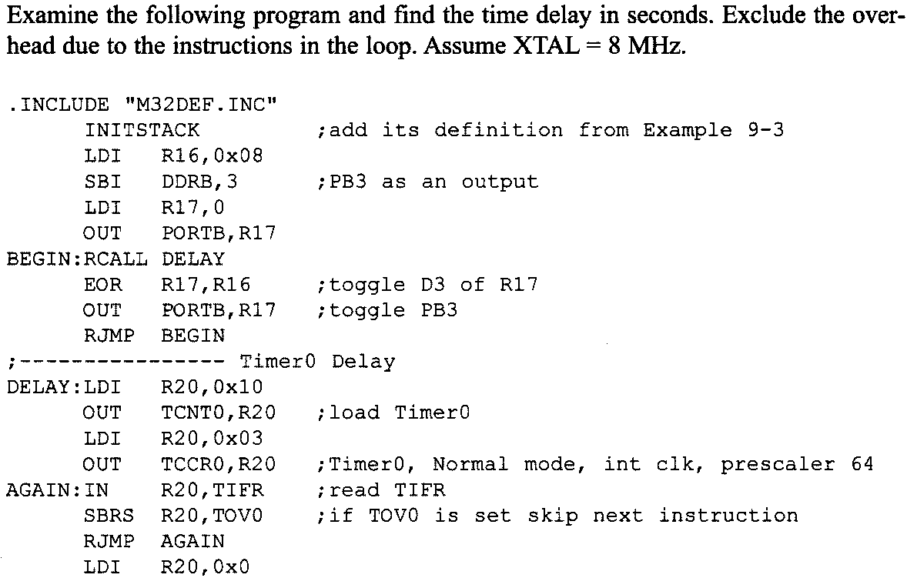
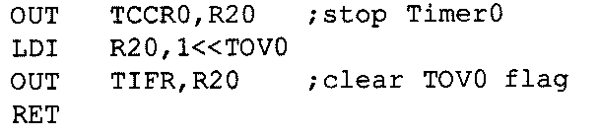

Slide 51
Prescalar=64
Frequency _{Timer} = Frequency _{clock} /64
=8Mhz/64 =125KHz
T= 8µsec
From the given equation
Required Delay= (256-XX) * T
Given, XX= 0x10 =16D
Required Delay= (256-16) * 8 µsec
=240 * 8µsec
=1920µsec

Slide 52
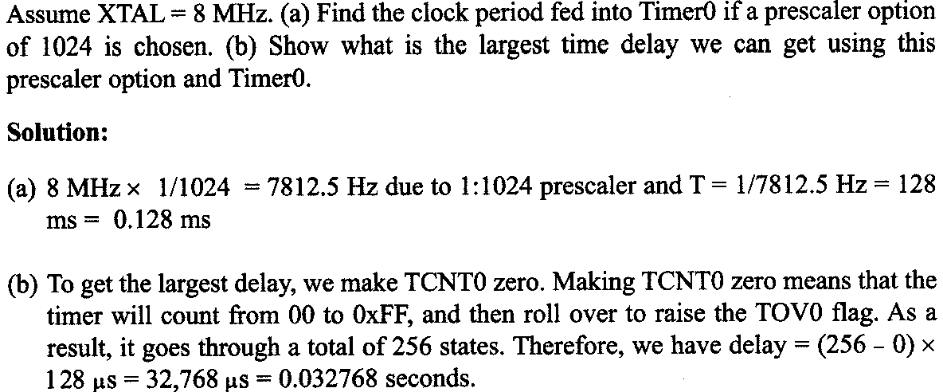

Slide 53
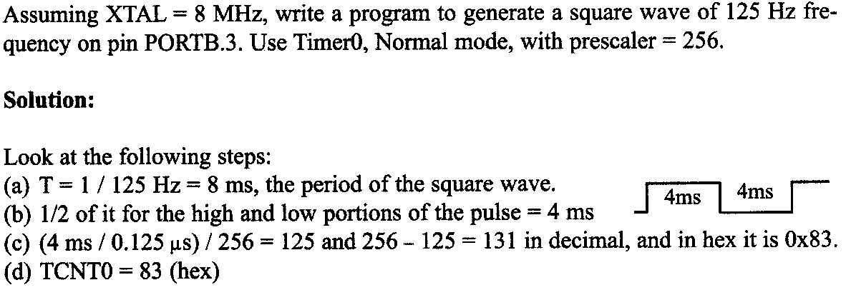

Slide 54
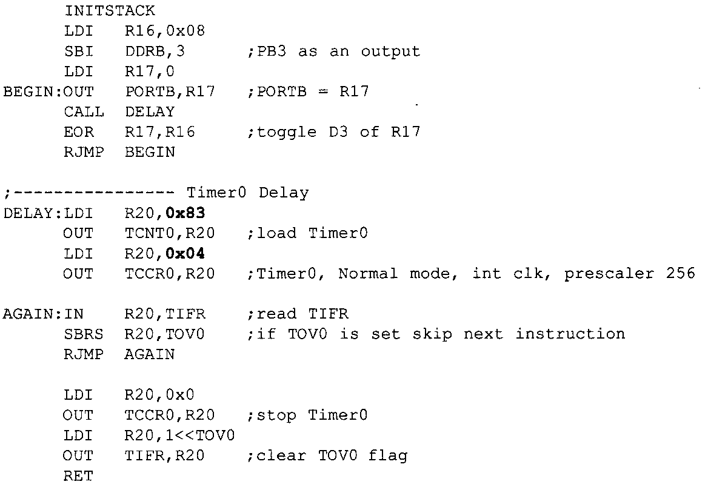

Slide 55
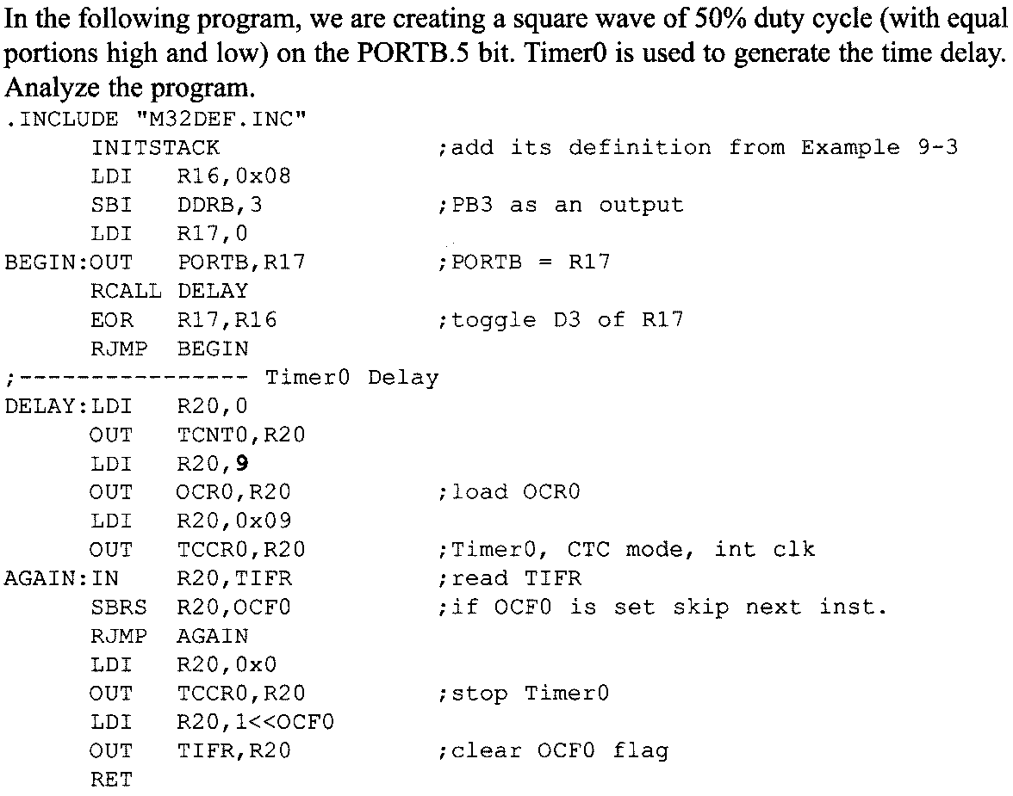
CTC mode Programming in Timer 0

Slide 56
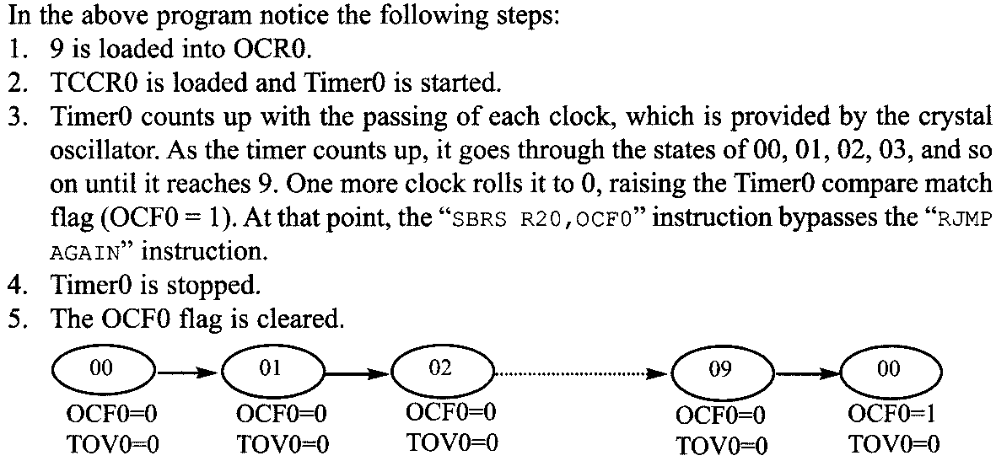
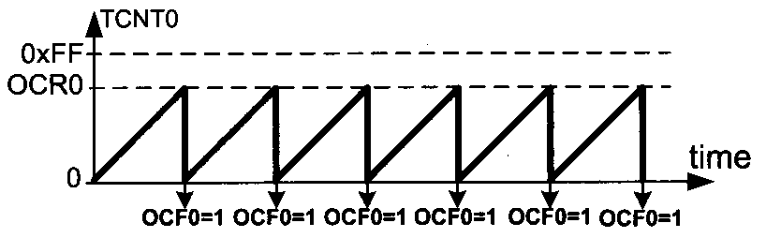

Slide 57
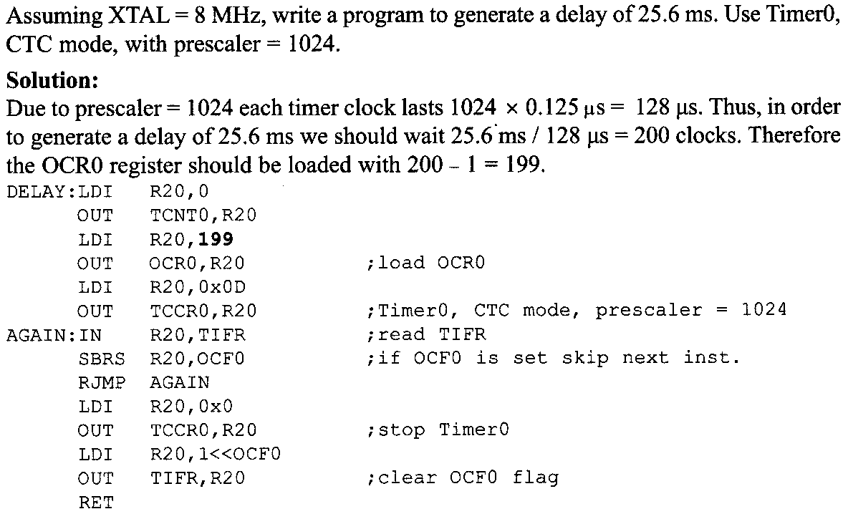

Slide 58
Timer 2 Programming
Timer 2 is also an 8-bit timer like timer 1
But there are few differences between both

Slide 59
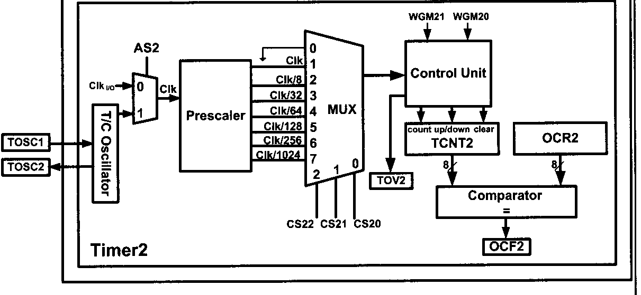
Timer 2

Slide 60
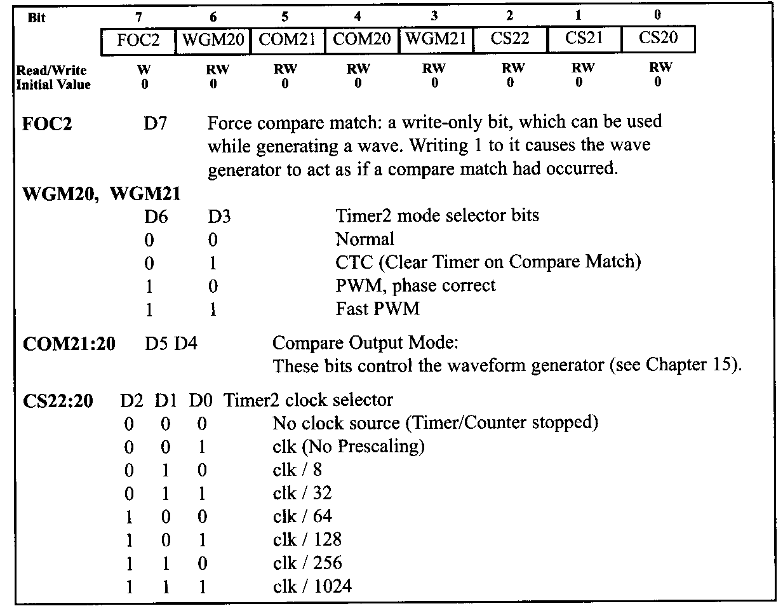
TCCR2 Register

Slide 61
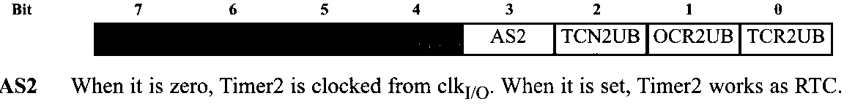
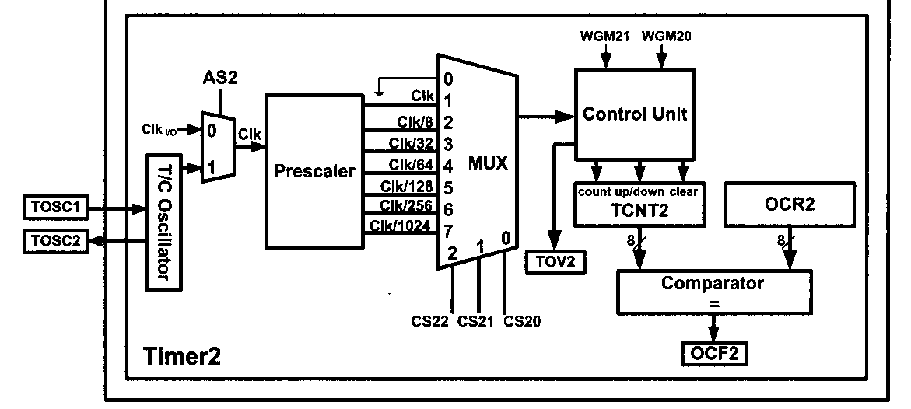

Slide 62
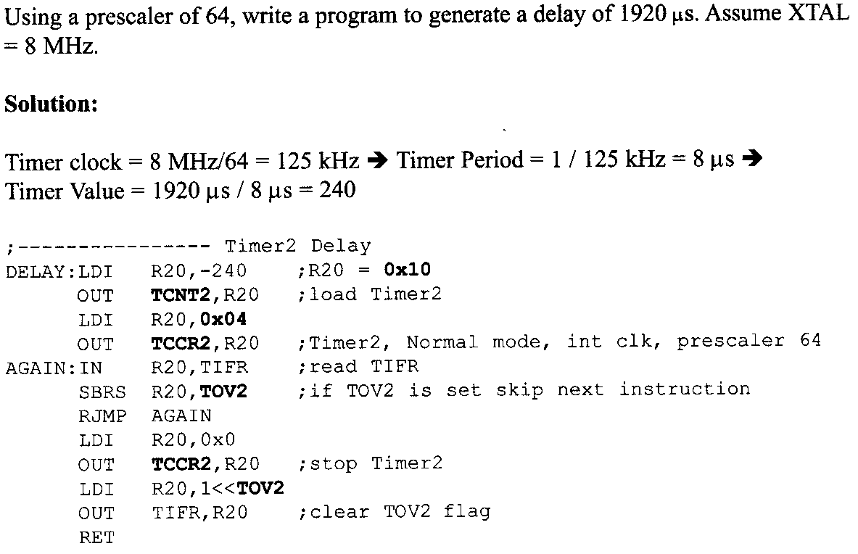

Slide 63
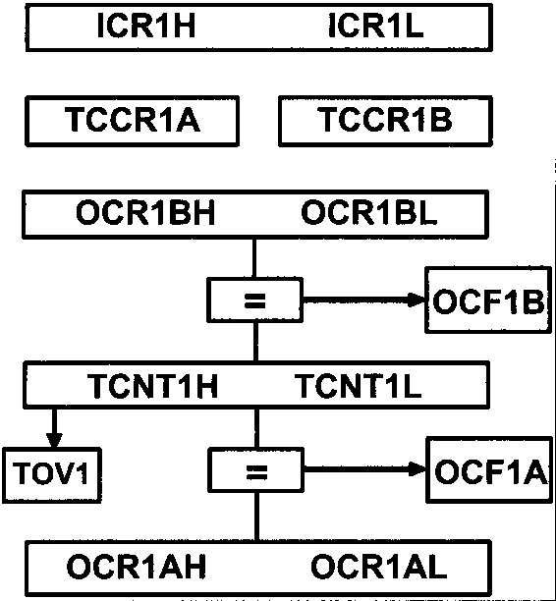
Timer 1 Programming
Timer1 is a 16-bit timer split into two 8-bit registers : TCNT1H and TCNT1L
It also has 2 control registers TCCR1A and TCCR1B
There are 2 OCR registers: OCR1A and OCR1B (each of 16-bit split as two 8-bit OCR1AH: OCR1AL & OCR1BH: OCR1BL)
Hence there are 2 flag registers: OCF1A and OCF1B

Slide 64
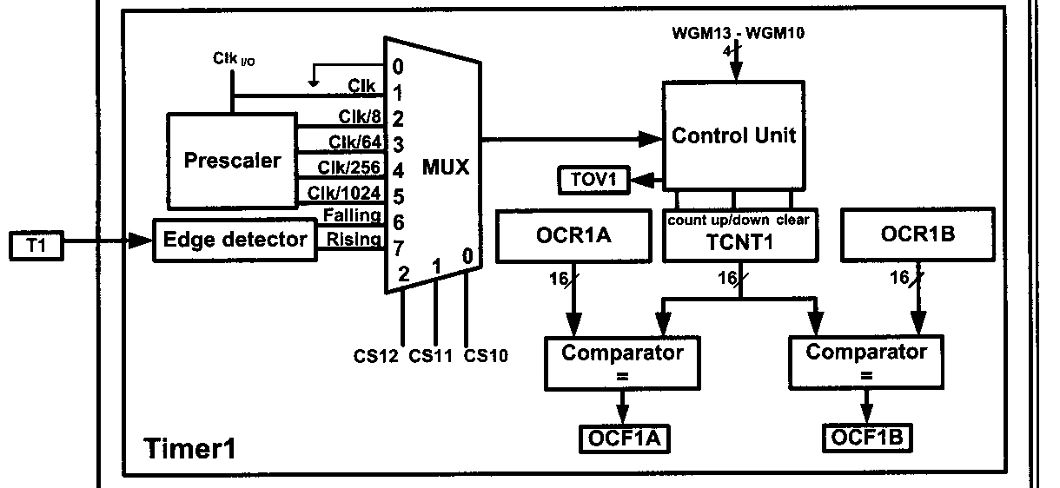
Timer 1

Slide 65
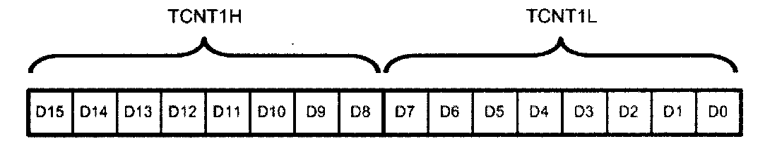
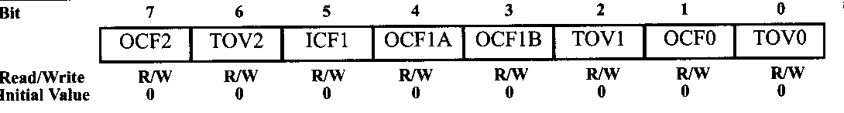
TCNT1 Register
TCNT1 counts upto FFFF
TOV1 flag goes HIGH when TCNT1 overflows from FFFF to 0000
Whenever TCNT1 equals OCR1A, OCF1A flag will be set ON for the next timer clock.
Whenever TCNT1 equals OCR1B, OCF1B flag will be set ON for the next timer clock.
TIFR Register

Slide 66
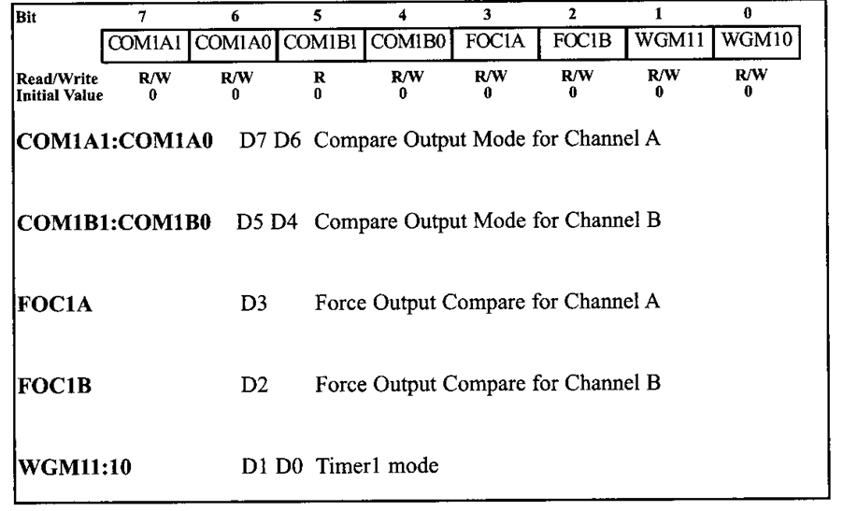
TCCR1A Register

Slide 67
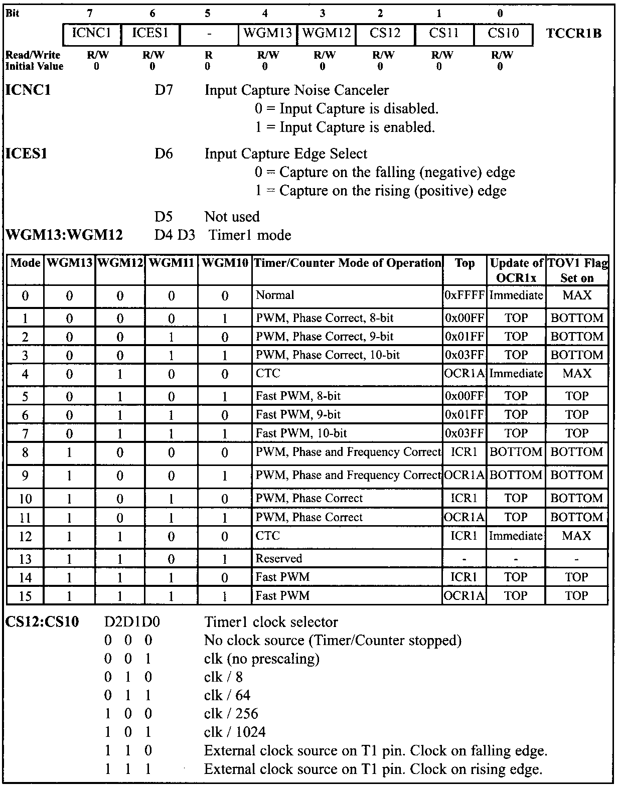
TCCR1B Register

Slide 68
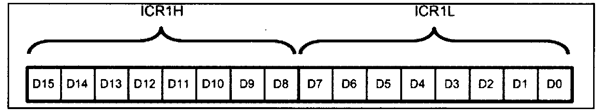
Input Capture Register (ICR)

Slide 69
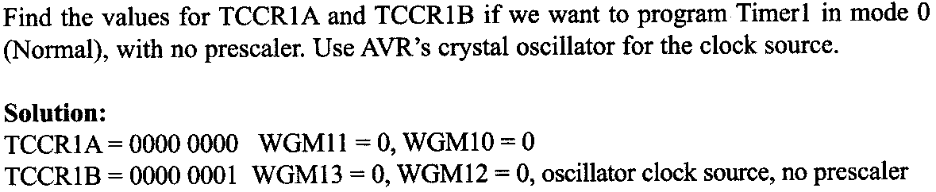
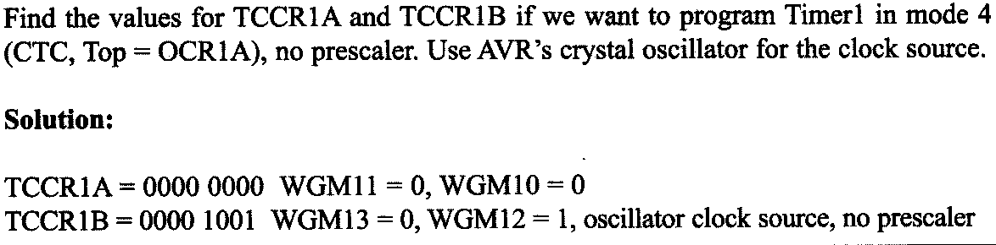
Ex 1:
Ex 2:

Slide 70
Delay Calculation in Timer 1
Required Delay= Count * T ---------------(1)
Count= FFFF - (XXYY-1)
=65535 - XX YY+1
=65536 - XX YY
Required Delay= (65536-XXYY) * T
XXYY= 65536-Required Delay/T
Where XXYY is the value to be loaded into TCNT1H (with XX) and TCNT1L (with YY)

Slide 71
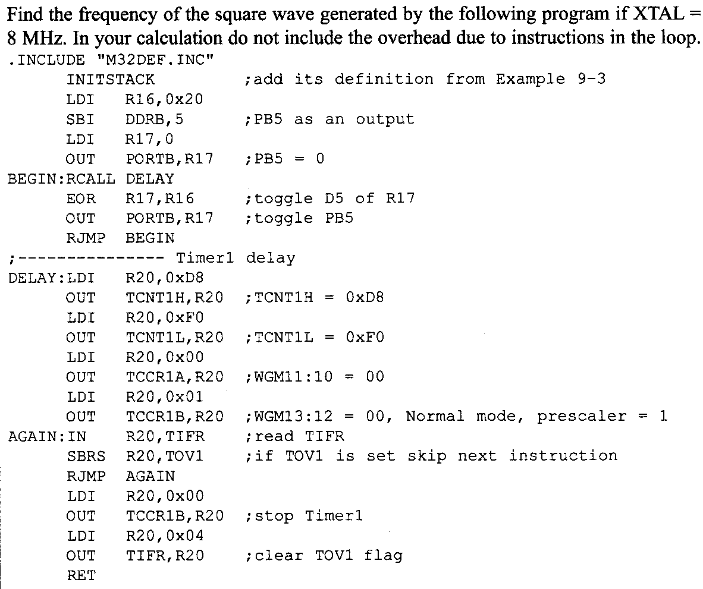

Slide 72

Solution:
In the above program, XXYY= D8F0, XTAL= 8MHZ,
∴T = 1/8 MHz = 0.125µs
Required Delay = (FFFF-XXYY+1) * T
= (FFFF- D8F0 + 1) * 0.125µs
= 10,000 * 0.125µs
= 1.25 ms
Time Period= 2 * Required Delay
= 2 * 1.25 ms = 2.5 ms
∴ Frequency= 400Hz

Slide 73
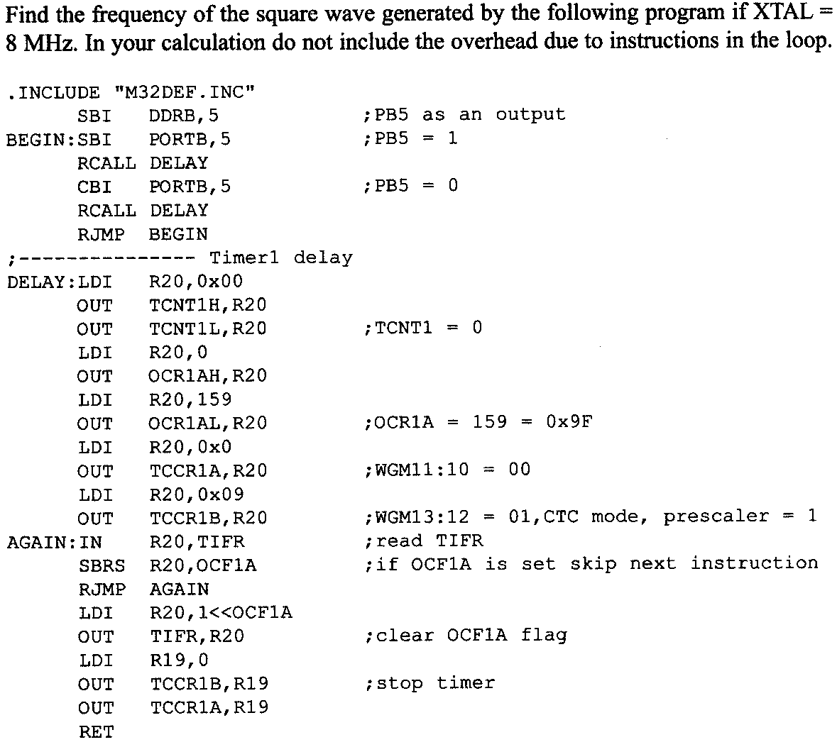

Slide 74
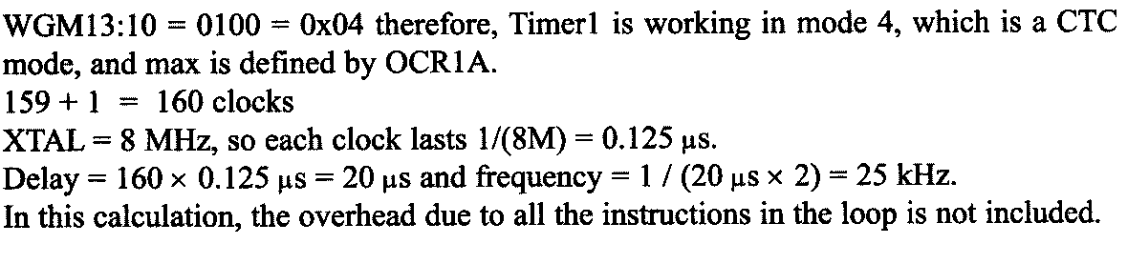
Solution:

Slide 75
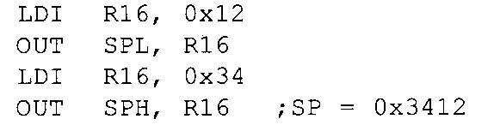
Accessing 16- bit Registers
AVR is an 8-bit register, hence it can manipulate data 8 bits at a time.
But Timer1 registers such as TCNT1, OCR1A, ICR1 and so on are 16-bit
TCNT1 = 0x15FF, we want to save the content of TCNT1 in R20 and R21
Read TCNT1L (0xFF) at t0, at the same cycle occurs TCNT=0x1600
Read TCNT1H (0x16)
The content is detected as 0x16FF instead of the correct value 0x15FF

Slide 76
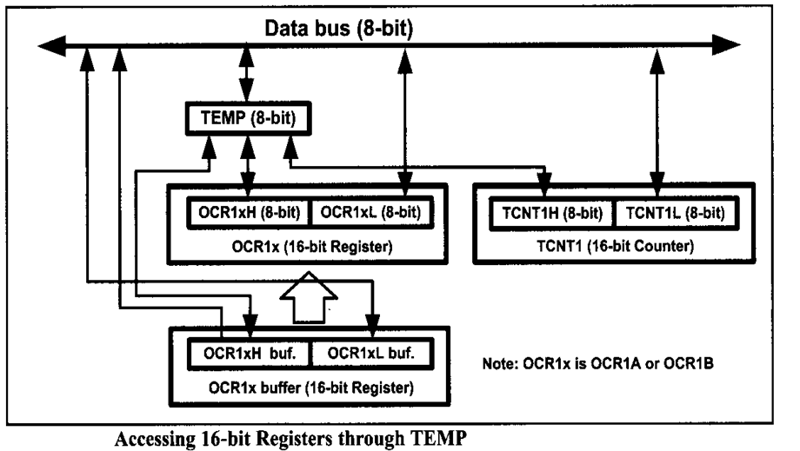

Slide 77
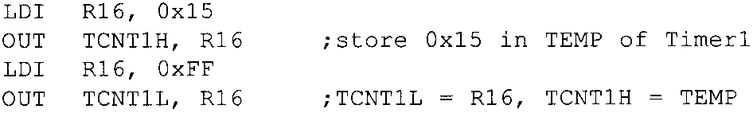
Solution:
But the AVR designers have resolved this issue with an 8-bit register called TEMP, which is used as a buffer.
When we write or read the high byte of a 16-bit register, the value will be written into the TEMP register
AVR buffers the high byte when the lower byte is read – When the higher byte is read, the buffered value is used

Slide 78


After the execution of “OUT TCNT1H, R16”, the content of R16, 0x15 will be stored in the TEMP register.
When the instruction “OUT TCNT1L , R16” is executed, the content of R16, 0xFF is loaded into TCNT1L and the content of TEMP register, 0x15, is loaded into TCNT1H, So, 0x15FF will be loaded into TCNT1 register at once.
We should first write into high byte of the 16-bit register and then into the lower byte
When we read the low byte of 16-bit register, the content of the high byte will be copied to the TEMP register
Notice that reading the OCR1A and OCR1B registers does not involve using the temporary register

Slide 79
COUNTER PROGRAMMING

Slide 80


Slide 81
The AVR timer can also be used to count, detect, and measure the time of events happening outside the AVR.
The use of the timer as an event counter is discussed.
When the timer is used as a timer, the AVR’s crystal is used as the source of the frequency.
When it is used as a counter, however, it is a pulse outside the AVR that increments the TCNTx register.
Notice that, in counter mode, registers such as TCCRn, OCRn, and TCNTn are the same as for the timer discussed in the previous session
They even have the same names

Slide 82
We know that the CS bits (clock selector) in the TCCR0 register decide the source of the clock for the timer.
If CS02:CS00 is between 1 and 5, the timer gets pulses from the crystal oscillator.
In contrast, when CS02:CS00 is 6 or 7, the timer is used as a counter and gets its pulses from a source outside the AVR chip.
You can as well load a count value in TCNT0 and start the timer from a specific count.
Another interesting feature is that a value can be set in the Output Compare Register (OCR0), and whenever TCNT0 reaches that value, the Output Compare Flag (OCF0) flag is Set.

Slide 83
Therefore, when CS02:CS00 is 6 or 7, the TCNT0 counter counts up as pulses are fed from pin TO (Timer/Counter 0 External Clock input).
In ATmega32, T0 is the alternative function of P0RTB.0.
Similar steps are used to configure Timer 1 and Timer 2 in various modes as timers or counters.

Slide 84



Ex 1:
Ex 2:

Slide 85


Slide 86
For Timer1 when CS12:10 is 6 or 7, the clock pulse coming in from pin T1 (Alternative function of PORTB.1) makes TCNT1 counter count up.
When CS12:10 is 6, the counter counts up on negative (Falling) edge
When CS12:10 is , the counter counts up on positive (Rising) edge

Slide 87




Slide 88




Slide 89


